Slide 1
Getting Started With

Slide 3
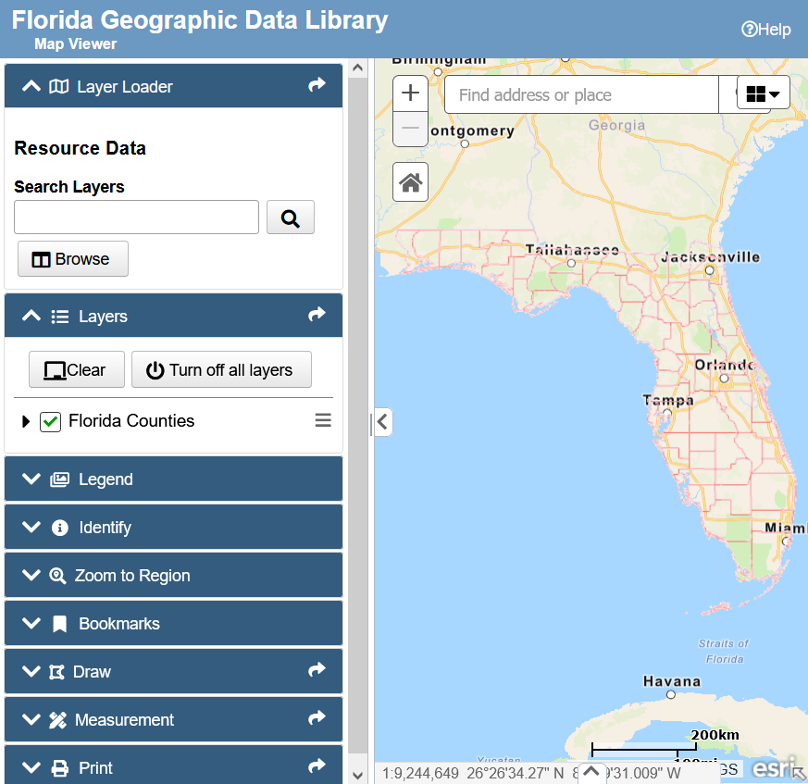
FGDL Explorer
Interactive map viewer you can use to:
Create and view maps online
Download geospatial data
Search layers
Browse data layers by source and topic
Does not include all data
Only the most current version of most layers
420+ layers (out of 500+ layers)
Ideal for:
Visually exploring data
Creating simple maps

Slide 4
Searching available layers in the FGDL Explorer

Slide 5
Browsing the FGDL Explorer by source and topic

Slide 6
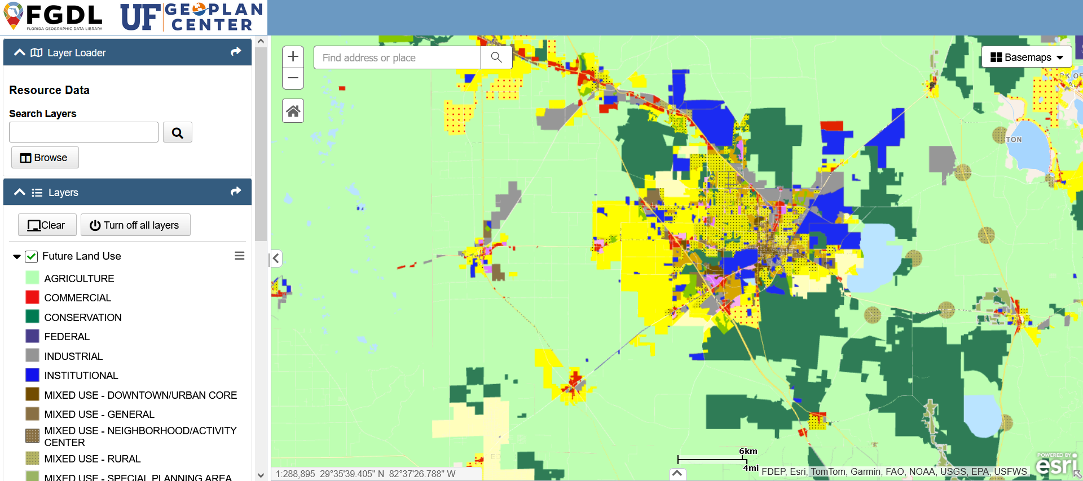
Viewing the Future Land Use layer in the FGDL Explorer

Slide 7
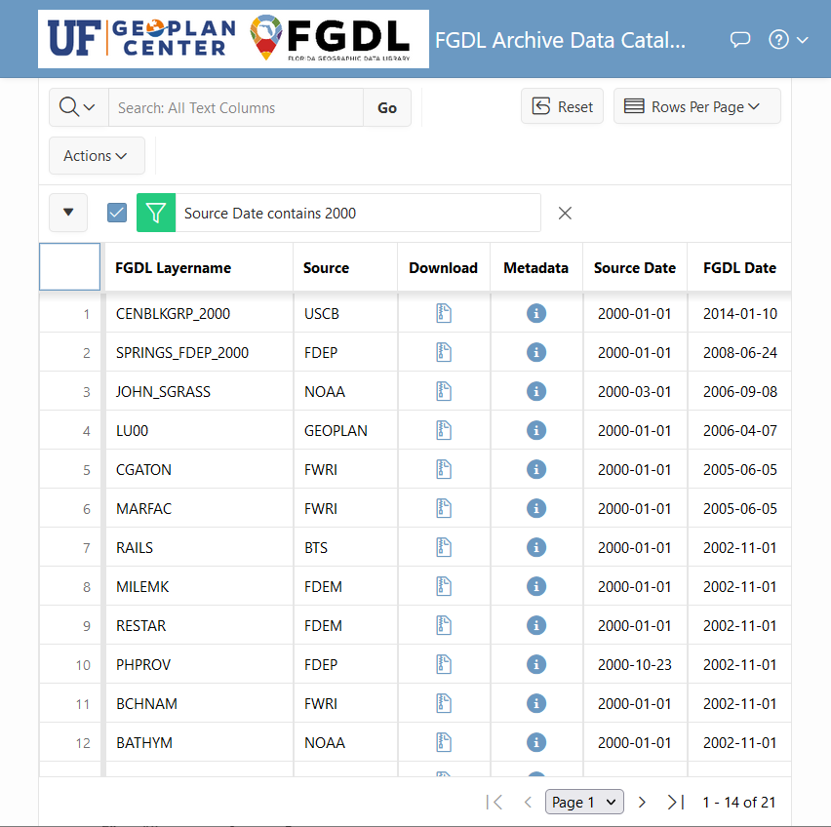
FGDL Archive Data Catalog
Interactive table you can use to:
Search data
Browse data
Download data
View metadata
Use map services
Includes filtering capabilities by column
Sortable columns
Includes all versions of all data layers (4800+ layers)
Ideal for:
Downloading historic data
Seeing everything offered by FGDL

Slide 8
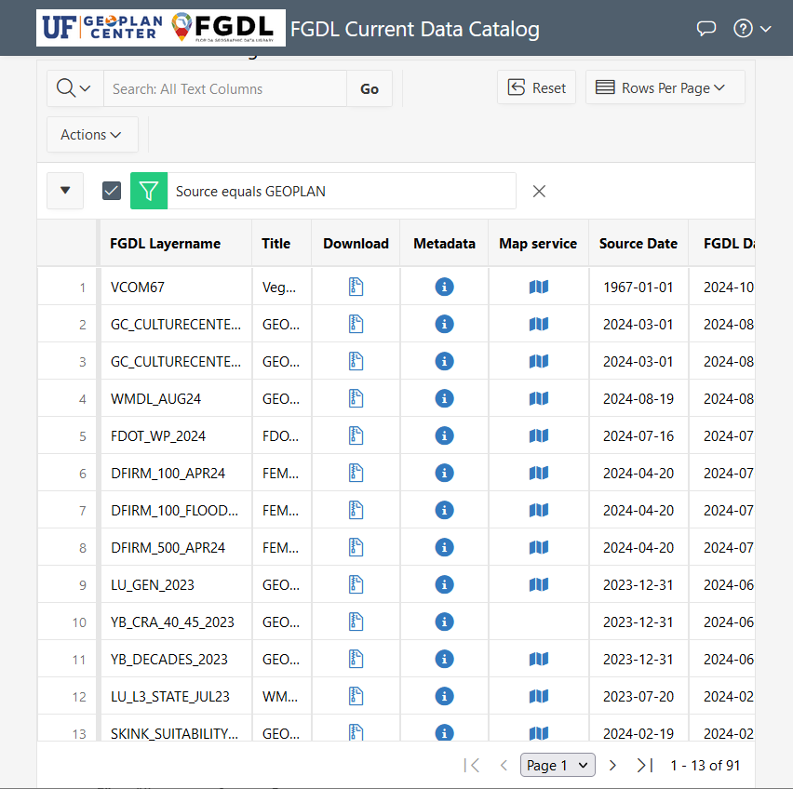
FGDL Current Data Catalog
Interactive table you can use to:
Search data
Browse data
Download data
View metadata
Use map services
Includes filtering capabilities by column
Sortable columns
Includes most recent version of all data layers (500+ layers)
Ideal for:
Easily downloading most recent version of data

Slide 9
Searching for data from 2010 in the Archive Data Catalog
All columns in the data catalogs are searchable

Slide 10
Searching for parcels from 2010 in the Archive Data Catalog
Apply multiply search filters at once

Slide 11
A look inside the FGDL Current Data Catalog
Download the data, view the metadata, or use a
map service through links in the catalog

Slide 12
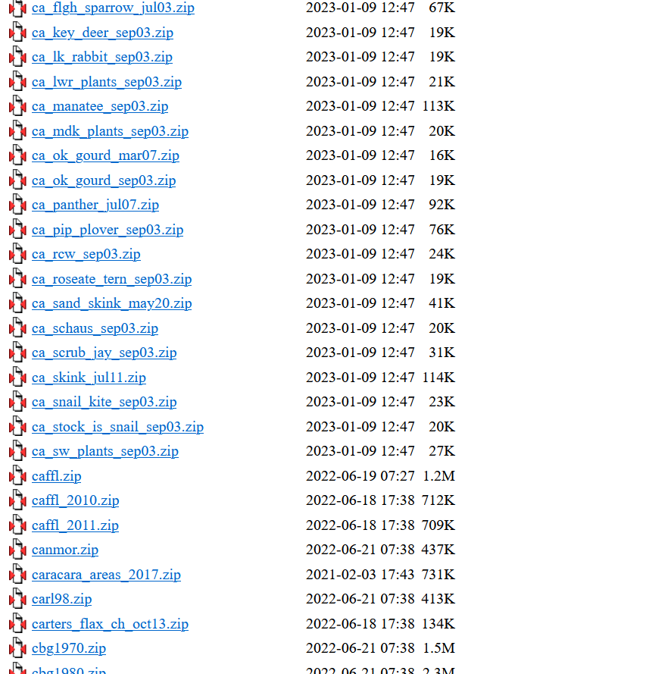
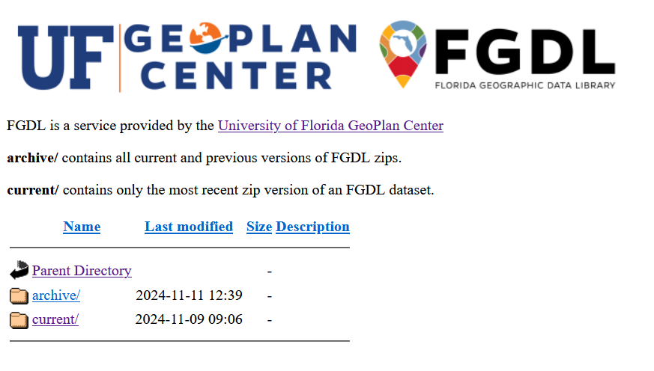
FGDL Zips
Direct download links to all available geospatial data and metadata
No information provided except layer name
Includes all versions of all data layers
Ideal for:
Downloading exact files

Slide 13
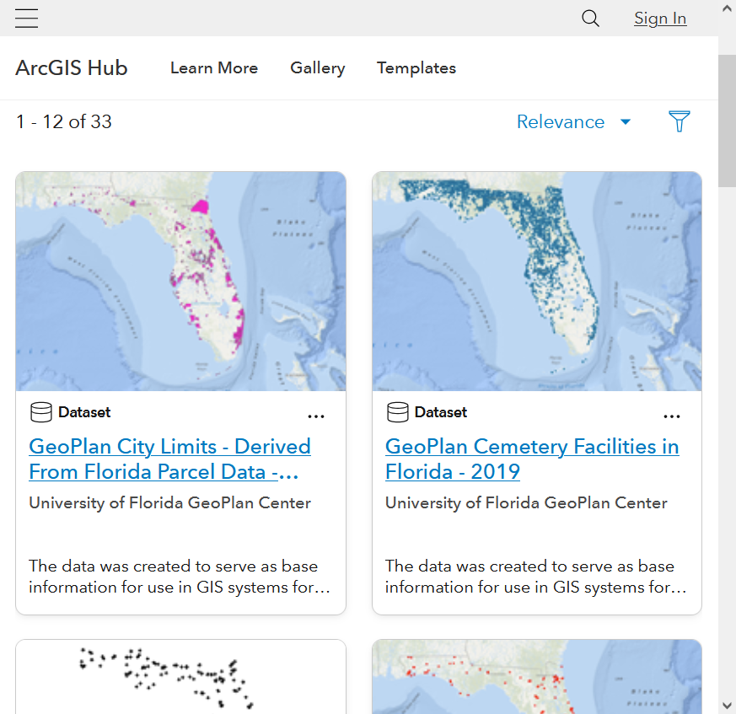
FGDL on AGOL
View and download a subset of FGDL layers on ArcGIS Online
These layers will only have GeoPlan Center as the authoritative source
Represents selected layers (30+) that FGDL publishes to AGOL
Ideal for:
Using pre-hosted data in ArcGIS Online
Quick overview of GeoPlan-authored data

Slide 14
Choosing to use a GeoPlan dataset on AGOL

Slide 16
Thank you!
Learn more at
fgdl.org

